Slide 1
Three Triangles and a Square
Inspired by a problem in TES resource
“Problems for Higher GCSE students” created by “lynneinjapan”
Found at:
https://www.tes.com/teaching-resource/problems-for-higher-gcse-students-11579173

Slide 2
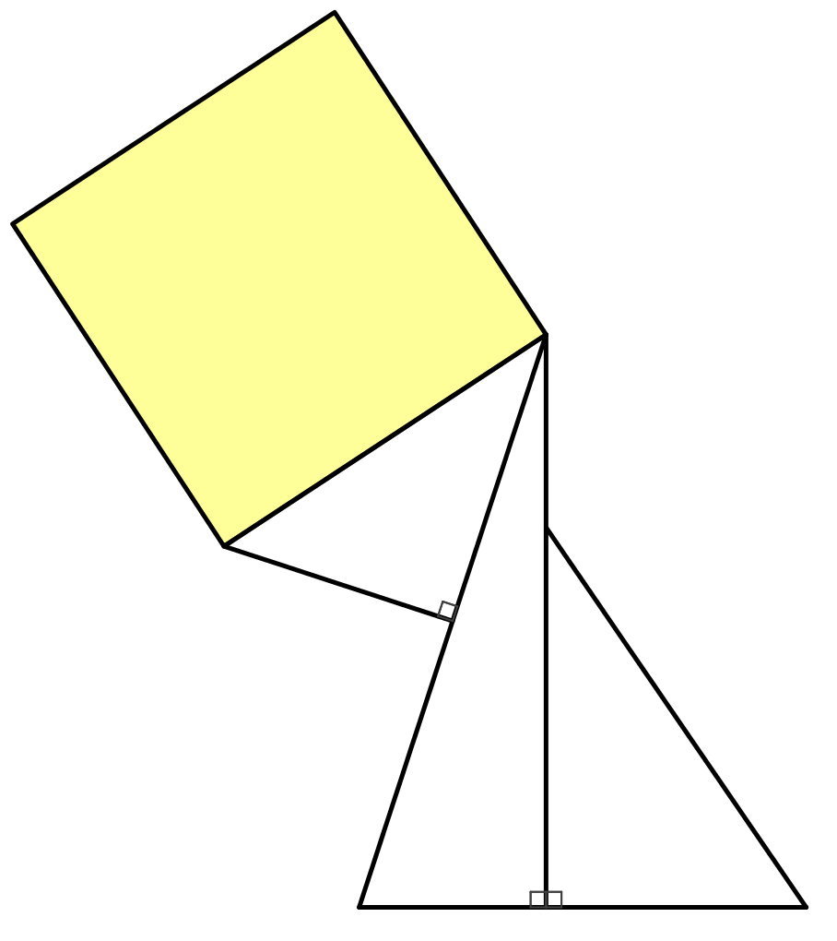





Three Triangles and a Square
The diagram shows a square and three right-angled triangles.
The dimensions shown are all in centimetres.
What is the area of the square?
Not drawn accurately.
$$12$$
$$5$$
$$2\sqrt{3}+1$$
$$12−\sqrt{6}$$
$$\sqrt{3}+2$$

Slide 3

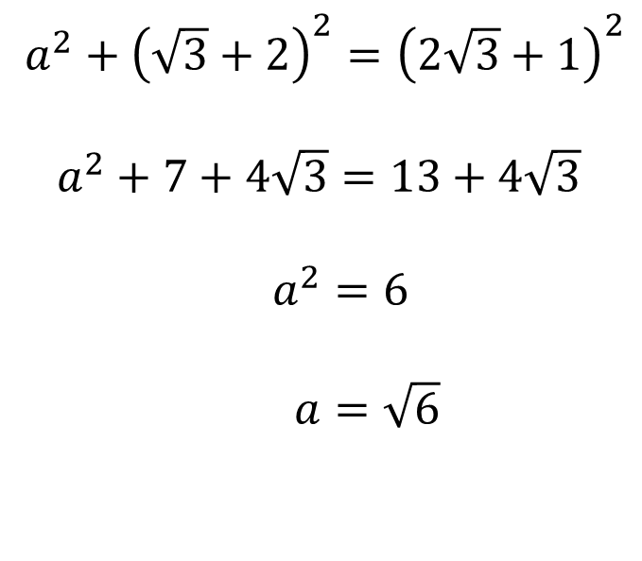


Three Triangles and a Square
Not drawn accurately.
$a^{2}+{\left(\sqrt{3}+2\right)}^{2}={\left(2\sqrt{3}+1\right)}^{2}$
$a^{2}+7+4\sqrt{3}=13+4\sqrt{3}$
$a^{2}=6$
$a=\sqrt{6}$
$$c$$
$$12$$
$$5$$
$$b$$
$$2\sqrt{3}+1$$
$$a$$
$$12−\sqrt{6}$$
$$\sqrt{3}+2$$

Slide 4
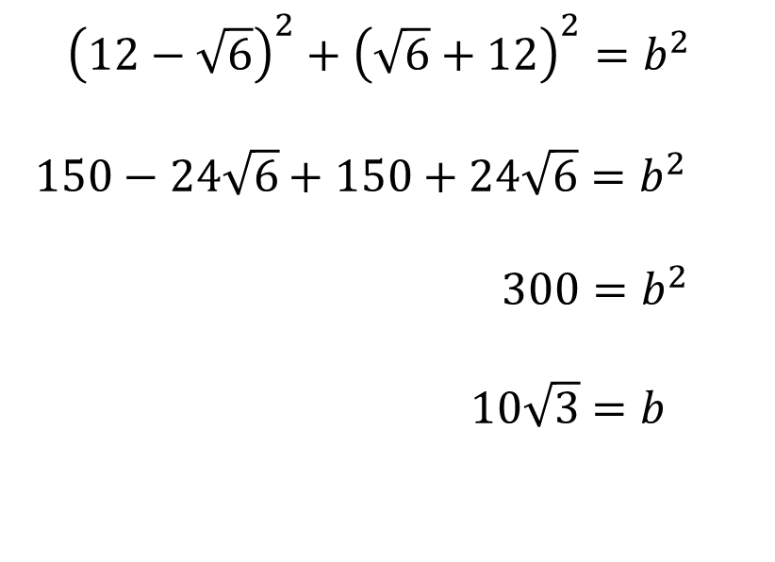

Three Triangles and a Square
Not drawn accurately.
${\left(12−\sqrt{6}\right)}^{2}+{\left(\sqrt{6}+12\right)}^{2}=b^{2}$
$150−24\sqrt{6}+150+24\sqrt{6}=b^{2}$
$300=b^{2}$
$10\sqrt{3}=b$
$$c$$
$$12$$
$$5$$
$$b$$
$$2\sqrt{3}+1$$
$$\sqrt{6}$$
$$12−\sqrt{6}$$
$$\sqrt{3}+2$$

Slide 5

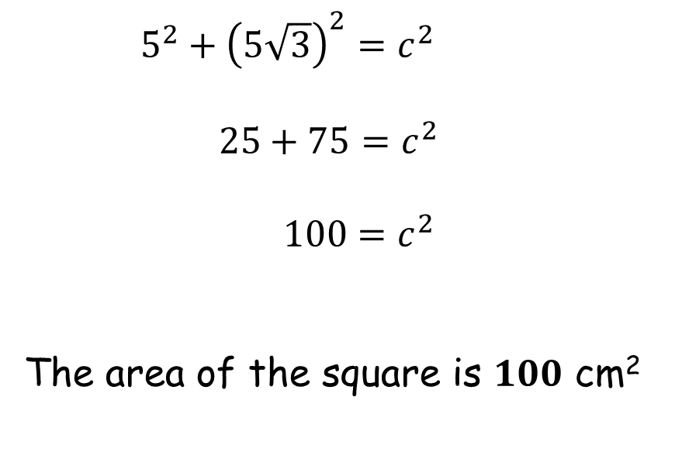


Three Triangles and a Square
Not drawn accurately.
$5^{2}+{\left(5\sqrt{3}\right)}^{2}=c^{2}$
$25+75=c^{2}$
$100=c^{2}$
The area of the square is $100$ cm²
$$c$$
$$12$$
$$5\sqrt{3}$$
$$5$$
$$10\sqrt{3}$$
$$2\sqrt{3}+1$$
$$\sqrt{6}$$
$$12−\sqrt{6}$$
$$\sqrt{3}+2$$

Slide 7
NOTE TO TEACHER
The answer is 100 cm² for all worksheets.

Slide 8
RESOURCES

Slide 9




Three Triangles and a Square
SIC_62
The diagram shows a square and three right-angled triangles.
The dimensions shown are all in centimetres.
What is the area of the square?
$$12$$
$$2$$
$$5\sqrt{3}+1$$
A
$$12−4\sqrt{3}$$
$$\sqrt{3}+5$$

Slide 10


Three Triangles and a Square
SIC_62
The diagram shows a square and three right-angled triangles.
The dimensions shown are all in centimetres.
What is the area of the square?
$$12$$
$$2$$
$$3\sqrt{7}+1$$
B
$$12−4\sqrt{3}$$
$$\sqrt{7}+3$$

Slide 11





Three Triangles and a Square
SIC_62
The diagram shows a square and three right-angled triangles.
The dimensions shown are all in centimetres.
What is the area of the square?
$$9$$
$$7$$
$$2\sqrt{8}+1$$
C
$$9−\sqrt{21}$$
$$\sqrt{8}+2$$

Slide 12





Three Triangles and a Square
SIC_62
The diagram shows a square and three right-angled triangles.
The dimensions shown are all in centimetres.
What is the area of the square?
$$4$$
$$8$$
$$3\sqrt{8}+1$$
D
$$2\sqrt{14}−4$$
$$\sqrt{8}+3$$

Slide 13



Three Triangles and a Square
SIC_62
The diagram shows a square and three right-angled triangles.
The dimensions shown are all in centimetres.
What is the area of the square?
$$12$$
$$2$$
$$2\sqrt{17}+1$$
E
$$12−4\sqrt{3}$$
$$\sqrt{17}+2$$

Slide 14




Three Triangles and a Square
SIC_62
The diagram shows a square and three right-angled triangles.
The dimensions shown are all in centimetres.
What is the area of the square?
$$12$$
$$1$$
$$2\sqrt{19}+1$$
F
$$12−3\sqrt{6}$$
$$\sqrt{19}+2$$

Slide 15




Three Triangles and a Square
SIC_62
The diagram shows a square and three right-angled triangles.
The dimensions shown are all in centimetres.
What is the area of the square?
$$8$$
$$8$$
$$3\sqrt{2}+1$$
G
$$8−2\sqrt{2}$$
$$\sqrt{2}+3$$

Slide 16




Three Triangles and a Square
SIC_62
The diagram shows a square and three right-angled triangles.
The dimensions shown are all in centimetres.
What is the area of the square?
$$12$$
$$4$$
$$5\sqrt{2}+1$$
H
$$12−2\sqrt{6}$$
$$\sqrt{2}+5$$

Slide 17


Three Triangles and a Square
SIC_62
The diagram shows a square and three right-angled triangles.
The dimensions shown are all in centimetres.
What is the area of the square?
$$12$$
$$2$$
$$7\sqrt{2}+1$$
I
$$12−4\sqrt{3}$$
$$\sqrt{2}+7$$

Slide 18




Three Triangles and a Square
SIC_62
The diagram shows a square and three right-angled triangles.
The dimensions shown are all in centimetres.
What is the area of the square?
$$3$$
$$8$$
$$8\sqrt{2}+1$$
J
$$\sqrt{63}−3$$
$$\sqrt{2}+8$$

Slide 19




Three Triangles and a Square
SIC_62
The diagram shows a square and three right-angled triangles.
The dimensions shown are all in centimetres.
What is the area of the square?
$$5$$
$$4$$
$$12\sqrt{2}+1$$
K
$$\sqrt{143}−5$$
$$\sqrt{2}+12$$

Slide 20


Three Triangles and a Square
SIC_62
The diagram shows a square and three right-angled triangles.
The dimensions shown are all in centimetres.
What is the area of the square?
$$7$$
$$2$$
$$12\sqrt{2}+1$$
L
$$\sqrt{143}−7$$
$$\sqrt{2}+12$$

Slide 21



Three Triangles and a Square
SIC_62
The diagram shows a square and three right-angled triangles.
The dimensions shown are all in centimetres.
What is the area of the square?
$$8$$
$$4$$
$$3\sqrt{14}+1$$
M
$$2\sqrt{26}−8$$
$$\sqrt{14}+3$$

Slide 22




Three Triangles and a Square
SIC_62
The diagram shows a square and three right-angled triangles.
The dimensions shown are all in centimetres.
What is the area of the square?
$$4$$
$$6$$
$$3\sqrt{15}+1$$
N
$$4\sqrt{7}−4$$
$$\sqrt{15}+3$$

